Slide 1
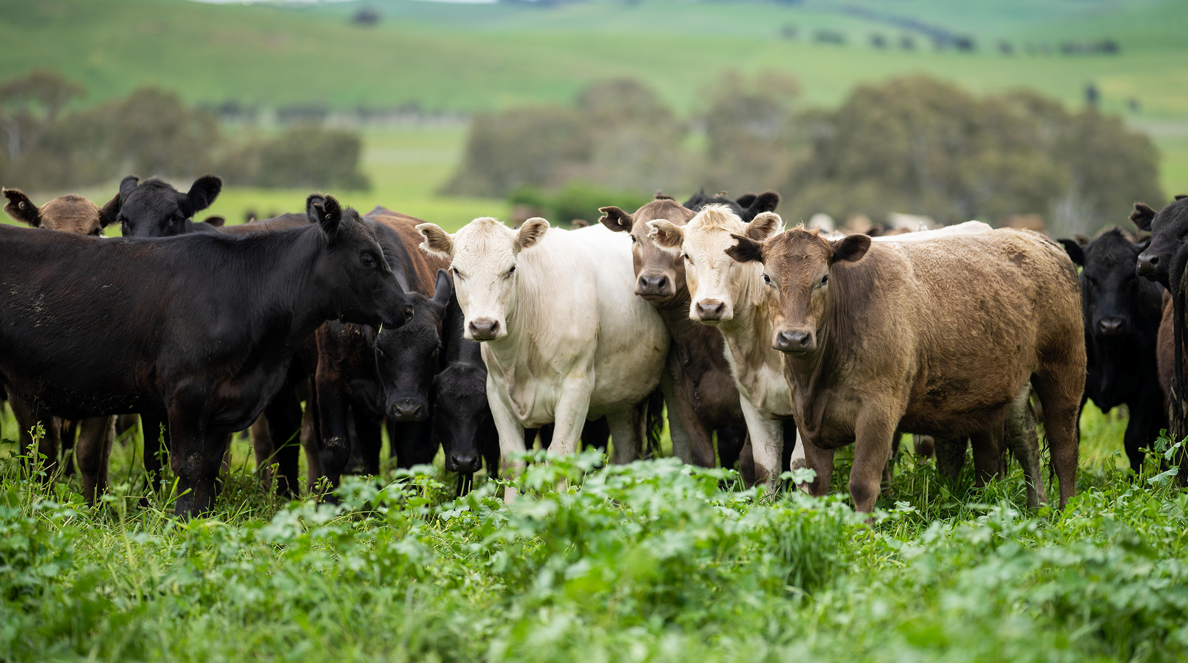







Monaro Farming Systems
2023 Summer (Soils) Field Day
Wednesday 6 December 2023 | Time: 8:30am – 4:30pm
'Woburn', 98 Gadens Road, Bungarby, NSW
COVID-safe rules will apply for this event – please do not attend if you are unwell.
MLA’s Producer Demonstration Site (PDS) program supports producers to adapt, validate and demonstrate the business value of integrating new management practices/skills into their local systems.
Overview of the PDS
Demonstrate effective management strategies to address the autumn/winter feed gaps in the Mediterranean zone to increase productivity, reduce risk and improve profitability.
Demonstrate the application of improved grazing practices to benefit productivity and sustainability, including the use of commercial tools and technologies.
Demonstrate adaptation to climate variability within a region through business planning, enterprise mix and risk management strategies.
What’s on the agenda?
Grazprophet Consulting – findings and results of MLA Producer Demonstration Site ‘Winter Feed Gap 2019’
Dr Richard Simpson – 2023 Soils Report and results from plant tissue testing (boron deficiency)
Edward McGeoch, Rabobank – commodity outlook
Rebecca Haling, CSIRO – updates on serradella trial and other factors important for successful establishment of serradellas
Specialised Livestock Services – parasite control advice with a focus on worm control, utilising data from diagnostics with the Monaro, and trends from previous worm egg counts.
This event is funded by Meat & Livestock Australia with the support of:
For more information:
Register here
Frances Lomas
0456 948 892
executive@monaros.com.au

