Slide 1
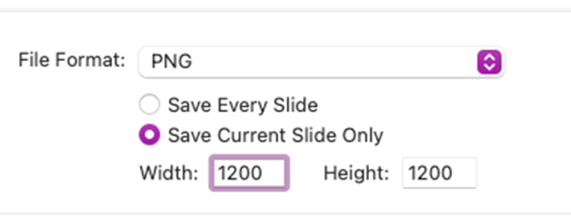
MLA PDS Event Template – Social Media tile
MLA have developed three social media tile templates for PDS events promotions.
Delete this instruction page and the template version you do not wish to use
To change the image
  Right click on the image and click change image
To insert a logo
  Go to the insert tab > pictures
  Place the logo in the designated space and resize to fit
  Click on the place holder and delete it
To save the social tile:
  Click on file > Export > and click the .png file type from the drop-down
  To get the best quality, select the following settings:
Submit the final version to MLA for review/approval

Slide 2




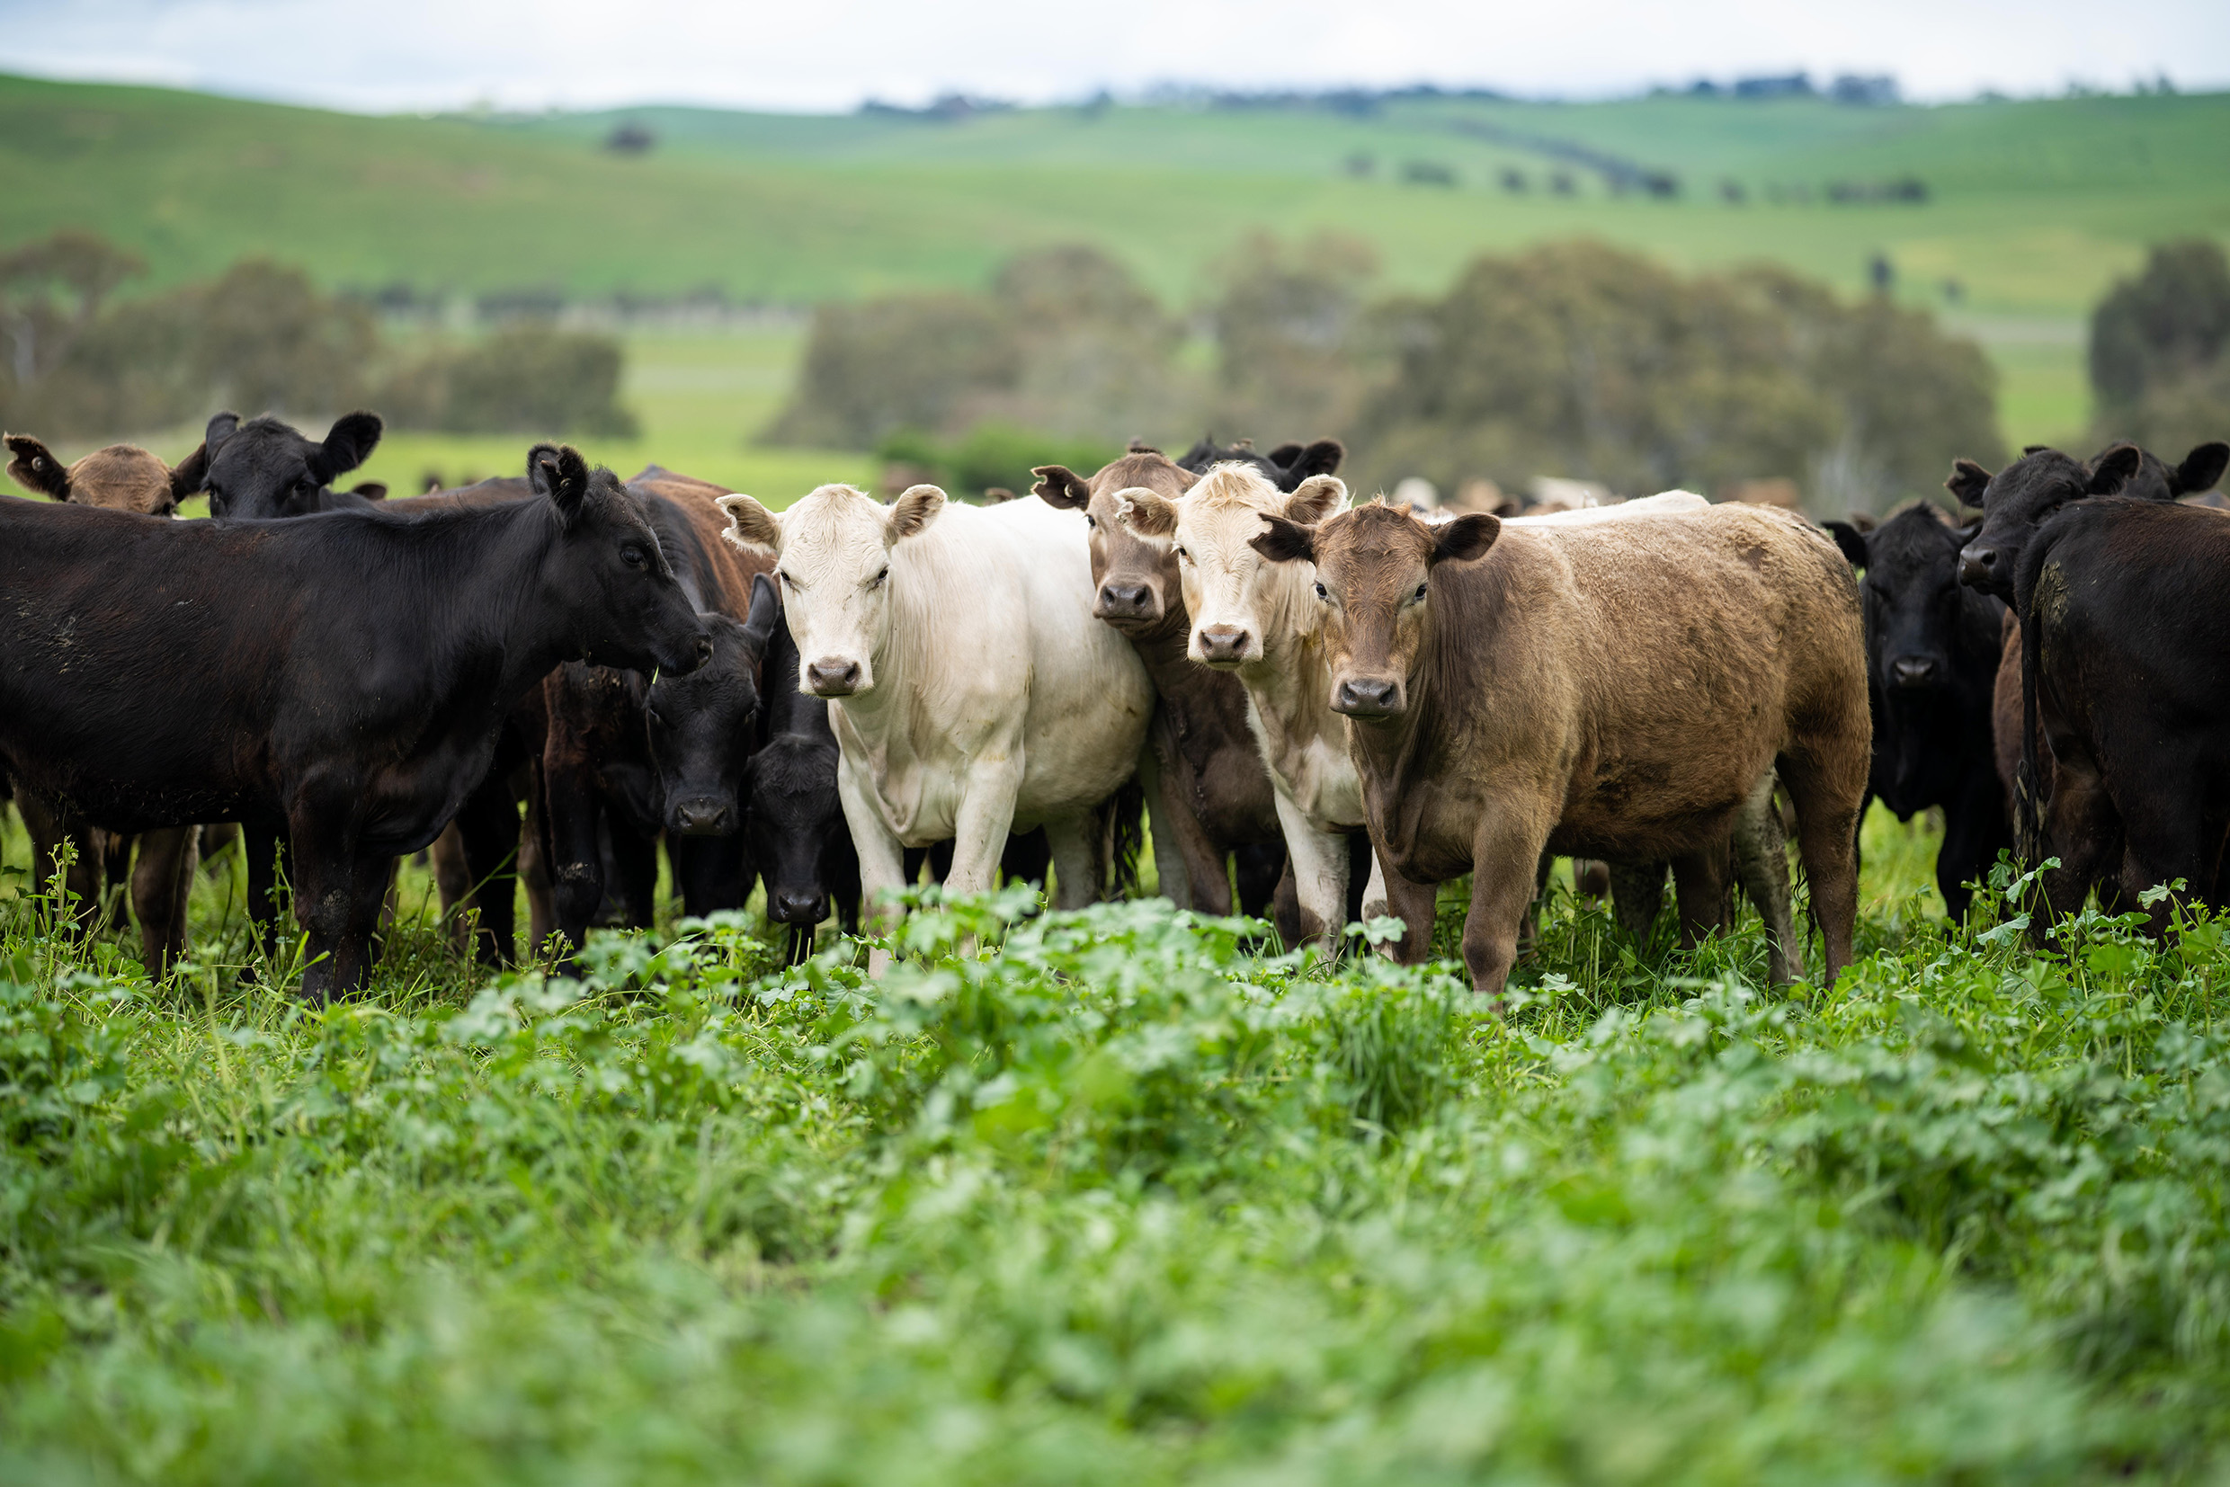
Replace with HOST logo
if applicable
Project/event name
Subheading
Day Month, Year | Time [00.00am]
Street address, Town/Suburb, STATE
RSVP by [Day, month]
For more information:
Contact name/company
Contact phone number
Contact email address
This event is funded by Meat & Livestock Australia with the support of:
Replace support logo
Replace support logo
Replace support logo

Slide 3
Replace with HOST logo
if applicable
Project/event name
Subheading
Day Month, Year | Time [00.00am]
Street address, Town/Suburb, STATE
RSVP by [Day, month]
For more information:
Contact name/company
Contact phone number
Contact email address
This event is funded by Meat & Livestock Australia with the support of:
Replace support logo
Replace support logo
Replace support logo

Slide 4
Replace with HOST logo
if applicable
Project/event name
Subheading
Day Month, Year | Time [00.00am]
Street address, Town/Suburb, STATE
RSVP by [Day, month]
For more information:
Contact name/company
Contact phone number
Contact email address
This event is funded by Meat & Livestock Australia with the support of:
Replace support logo
Replace support logo
Replace support logo

